Slide 1
National Accounts and
environmentally
Sustainable National Income
Roefie Hueting and Bart de Boer
July 11 2019
www.sni-hueting.info

Slide 2
Contents
Part 1: Tour d’horizon
10 minutes for informative questions
Part 2: More on theory
30 minutes discussion
<number>

Slide 3
Motivation and development
Wonderment in 1965: Children could no longer play in the streets. This is not deducted from national income. Building a concrete playing area is accounted as an addition to national income
1967 Jan Tinbergen and 1969 CBS Department of environmental statistics
1974 thesis: New Scarcity and Economic Growth. More welfare through less production?
1986: Development of the notion of eSNI
1991: Article with Tinbergen: GNP and Market Prices: Wrong Signals for Sustainable Economic Success that Mask Environmental Destruction
“Bicycle, bean and condom”
<number>

Slide 4
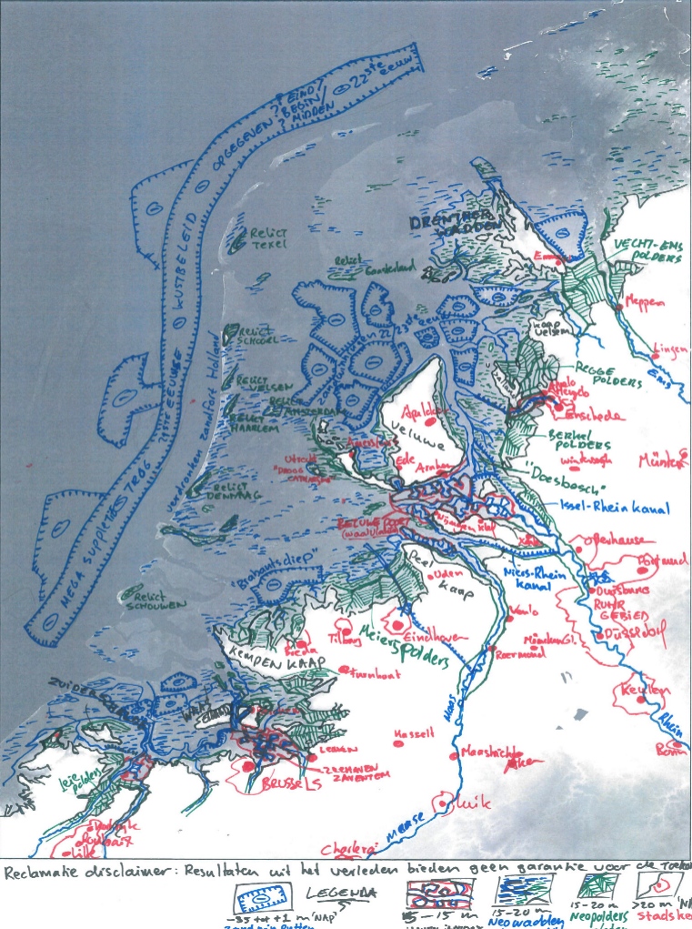
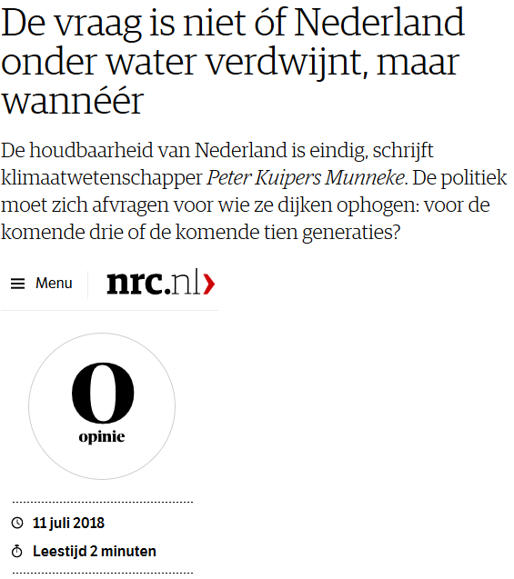
The question is not whether the Netherlands will be flooded but when
Kim Cohen (UU)
Vrij Nederland 9 feb 2019
About possibly the year 2300
<number>

Slide 5
At least 2 groups of users of statistics
Everyone seems to wish “sustainability”, but without a good definition. The notion of sustainability is ambiguous. Therefor environmental sustainability.
Statistics has at least 2 kinds of clients on this topic:
Group 1: Limits to growth.
Group 2: Optimism on technology.
Economic statistics has a gap in information.
Statistics is not about future technology.
<number>

Slide 6
Information from economic science
Our planet is threatened by a wrong belief in a wrongly formulated growth.
The term 'economic growth' can only mean a growth in welfare, but is often and incorrectly identified as production growth that may actually damage the environment.
The figure of standard national income (NI) or GDP is useful for many purposes but inadequate for environmental policy.
A figure of eSNI or eGDP is required alongside NI.
<number>

Slide 7
Environment from an economic perspective
What is economic behaviour?
All economic behaviour is directed at the satisfaction of wants. Said in another way: it is directed at (individual) welfare.
Welfare is influenced by more factors than only production (income).
Welfare exists in personal experience and is not measured in cardinal units.
There are more measurable factors that influence welfare (work, leisure, distribution of income, ….).
<number>

Slide 8
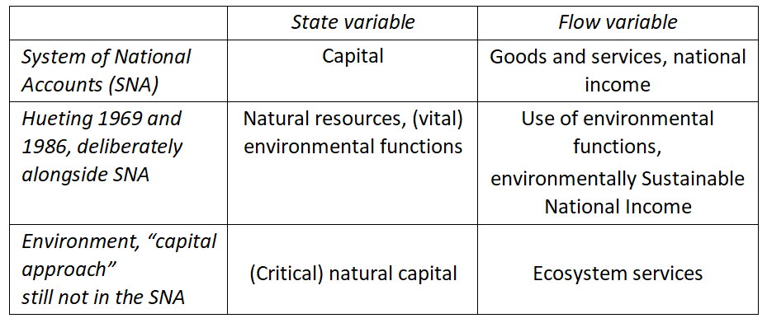
Terminology (Babylon)

Slide 9
Environmental sustainability
Use of the environment: use of natural resources, emission of waste materials
Environmentally sustainable use: maintaining the functions (possibilities for use) for future generations
eSNI = maximally feasible production under the condition of environmental sustainability
eSNI is an indicator for environmental sustainability and one of the factors that influence welfare (thus it is not an indicator for welfare)
<number>

Slide 10
Standards for environmental sustainability
Standard: restriction to environmental use (resources, emissions) when such use causes an environmental problem, e.g. climate change, erosion, over-fertilisation
Derived from the literature about maintaining environmental functions: biodiversity, human health, spatial availability of all functions
<number>

Slide 11
Definitions NI and eSNI
Standard national income NI = sum of all added value = production
Environmentally sustainable national income eSNI = maximal production, with the technology of the year of observation, such that the environmental functions - i.e. possible uses of the not-human-made physical surroundings – remain available for future generations
<number>

Slide 12
What matters is the distance
eΔ= NI – mDNI
Ignore or reduce eΔ
<number>

Slide 13
NI, eSNI, eΔ= NI - eSNI, Netherlands 1990-2015
<number>

Slide 14
A proof of concept
Hueting & De Boer (2019). eΔ ≈ NNI – eSNNI. eFootprint = 100 / %
GDP = Gross Domestic Product. NNI = Net National Income. Red: rough estimate
<number>

Slide 15
Why environmental sustainability is very cheap,
“though it costs half NI”
NI = eSNI + eΔ gives the loss of functions eΔ (costs), that is to be avoided when one desires environmental sustainability
Adapting human behaviour and the size of the population to the collectively available possibilities of the physical surroundings is easily affordable, but requires sacrifices indeed.
Bicycle, bean, condom.
If we want it then we can start today.
<number>

Slide 16
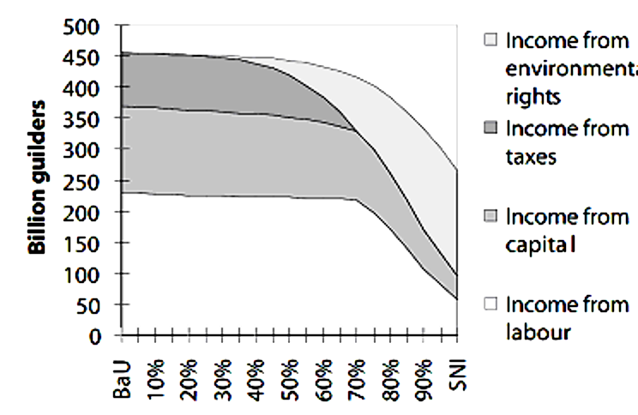
Other results by the model 1: Ranking of the measures
<number>

Slide 17
Other results by the model 2: Shadowprices per sector
Economic-statistically calculated shadowprices for environmental sustainability could be used for Cost-Benefit Analyses by cities and provinces and for investments by pension funds.
This can contribute to the coordination for data and policy. Much of this work currently uses marketprices that are not environmentally sustainable. Thus there is a clear risk that such investments are environmentally unsustainable.
eΔ would be a target variable for the environmental agency PBL.
<number>

Slide 18
Information for “Limits” and “Optimism on technology”
To impose restrictions for the environment doesn’t mean a ‘return to the Middle Ages’
It does mean: A discussion on how to maintain welfare within the boundaries given by environmental sustainability
eSNI fills the information gap, namely by providing information about environmental scarcity
The public and policy makers can subsequently use that information
PM. Statistics about the past can do little with expectations about technology
<number>

Slide 19
Are there informative questions?
(10 minutes, and then Part 2)
<number>

Slide 20
Repeat
Our planet is threatened by a wrong belief in a wrongly formulated growth.
The term 'economic growth' can only mean a growth in welfare, but is often and incorrectly identified as production growth that may actually damage the environment.
The figure of standard national income (NI) or GDP is useful for many purposes but inadequate for environmental policy.
A figure for eSNI or eGDP is required alongside NI.
<number>

Slide 21
Old and new scarcity
Environmental functions are possible uses of the not-human-made physical surroundings
Competing functions are scarce, and thus economic, goods
Economic activity concerns scarcity and comprises both production and the use of the environment
The environment belongs to the subject matter of economics, thus also to economic statistics
<number>
Notes:
Daarom moeten we het doen met wel meetbare factoren die beargumenteerbaar de welvaart beïnvloeden. Zoals werkloosheid, nationale en internationale inkomensverdeling, arbeidsomstandigheden en schaarse milieufuncties.
Milieufuncties zijn de gebruiksmogelijkheden van de niet door de mens ge maakte fysieke omgeving: water, bodem,lucht, grondstoffen, planten en diersoorten en de life support systems die het leven op aarde mogelijk maken zoals de water- en de koolstof kringloop.
Zodra het ene gebruik ten koste gaat van het andere zijn milieufuncties per definitie schaarse dus economische goederen en wel de meest fundamentele waarover de mens beschikt omdat de productie en het menselijk leven ervan afhankelijk zijn.
De meeste conflicten tussen milieufuncties komen neer op …..

Slide 22
Old and new scarcity 2
Most scarcity is caused by the use of environmental functions for production or standaard national income (NI).
Alternative to this: production that maintains environmental functions for future generations.
NI is based upon marketprices.
Shadowprices of the functions are unknown up to now.
This is theoretically unsolvable.
<number>
Notes:
Daarom moeten we het doen met wel meetbare factoren die beargumenteerbaar de welvaart beïnvloeden. Zoals werkloosheid, nationale en internationale inkomensverdeling, arbeidsomstandigheden en schaarse milieufuncties.
Milieufuncties zijn de gebruiksmogelijkheden van de niet door de mens ge maakte fysieke omgeving: water, bodem,lucht, grondstoffen, planten en diersoorten en de life support systems die het leven op aarde mogelijk maken zoals de water- en de koolstof kringloop.
Zodra het ene gebruik ten koste gaat van het andere zijn milieufuncties per definitie schaarse dus economische goederen en wel de meest fundamentele waarover de mens beschikt omdat de productie en het menselijk leven ervan afhankelijk zijn.
De meeste conflicten tussen milieufuncties komen neer op …..

Slide 23
Welfare, income and environment
Without assumptions about behaviour any figure of national income is meaningless (according tot welfare economics).
This holds for both NI and eSNI.
Risk and the precautionary principle are important grounds for the approach via conditionality.

Slide 24
Practical approach for an unsolvable problem: conditionality in measurement
eSNI is based upon standards for environ-mental sustainability (literature study) and upon a conditional assumption of preferences for environmental sustainability
<number>

Slide 25
Relation ecology and economics
<number>

Slide 26
Conditionality of NI and eSNI
The crucial awareness concerns the conditionality via assumptions.
NI is correct under the condition that the preferences result into current market prices.
eSNI is correct under the condition of preferences for maintaining environmental functions for future generations.
<number>

Slide 27
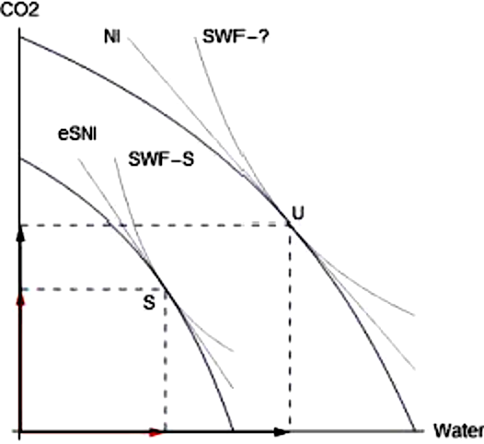
Social Welfare Function (SWF) Production Possibility Frontier (PPF)
NI in point U is a weighted sum of the use of environmental functions under market prices
eSNI in point S is a weighted sum of the standards under shadow prices
Whether SWF-? or SWF-S is highest is determined by assumptions
eΔ = NI – eSNI
<number>

Slide 28
A model: thus additional (but limited) uncertainty
The model estimates reactions by economic agents to changes in the price ratios: this causes changes in the patterns of production and consumption.
The shadow prices and the new level of production give eSNI.
Without satisfying the conditions for environmental sustainability, including the changing prices ratios, environmental sustainability cannot be reached.
<number>

Slide 29
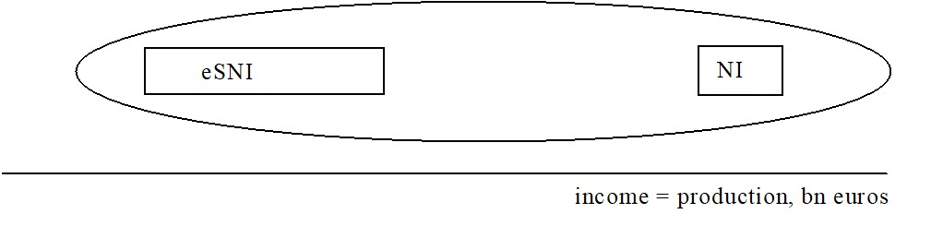
Validity versus uncertainty
NI and eSNI use the same raw data but account differently
boxes = horizontal ranges of error or uncertainty in measurement
boxes around NI and eSNI: technical issues w.r.t. the definitions
oval, eΔ: (i) NI is invalidly called income if preferences are for environmental sustainability, (ii) eSNI is only part of income if preferences are not for environmental sustainability.
<number>

Slide 30
CBS myth of “indisputable statistics”
Within CBS Statistics Netherlands there is a myth that CBS-statistics must be “indisputable”. However:
When there is uncertainty: then do research to determine how much.
The quality of statistics resides in the scientific base and approach.
NI is disputable, namely for the application in environmental policy.
<number>

Slide 31
Why eSNI is unique
eSNI is the only indicator that simultaneously
is directly comparable with NI
shows the relation of the physical surroundings (ecology) and subjective preferences (economcs)
measures the distance eΔ = NI - mDNI between the current and the environmentally sustainable situation
shows whether we are getting closer to environmental sustainability or further away from it
gives outcomes per sector.
<number>

Slide 32
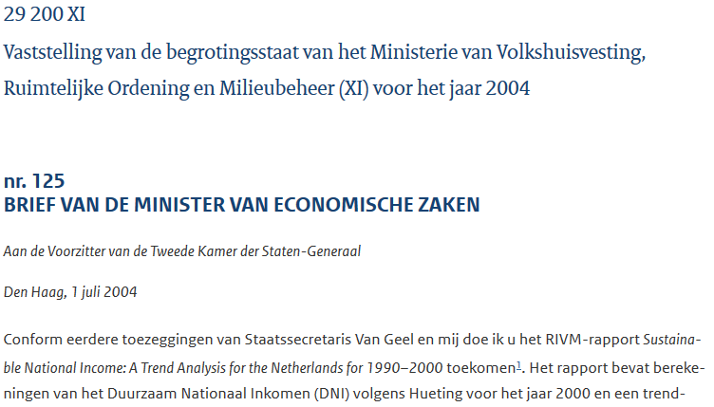
2004
https://zoek.officielebekendmakingen.nl/kst-29200-XI-125.html
<number>

Slide 33
In anticipation of this, the Ministries of Economic Affairs and VROM have not budgeted any resources for future eSNI calculations. To safeguard the future of eSNI, Mr Van Geel has agreed with RIVM that RIVM will assume responsibility for eSNI calculations in the future and that it will do calculations periodically (once every five years as it currently does). This agreement will still be formally arranged. As with previous calculations, CBS Statistics Netherlands will provide the required data and the Institute for Environmental Issues (IVM, University of Amsterdam) will be involved to perform the model calculations. The Ministry of VROM will make sufficient financial resources available to RIVM to be able to pay CBS Statistics Netherlands and IVM. RIVM will publish eSNI in regular RIVM publications such as the Environmental Balance Sheet or the Sustainability Monitor. In accordance with the wishes of the House of Parliament, this can be done in conjunction with research into and publication of other sustainability indicators. [Our translation]
<number>

Slide 34
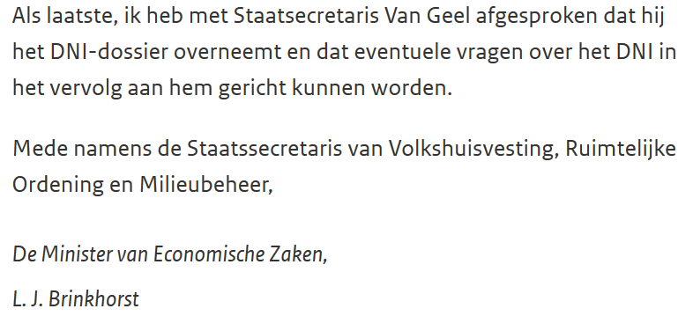
RIVM / MNP / PBL stopped calculation after 2008.
On this, there were neither scientific clarification nor possibility for discussion.
<number>

Slide 35
What does it cost to calculate eSNI? 5 personyears
The base material has already been collected for other purposes. (The restart would require a larger investment before researchers develop routine.)
Cost items are: data on environmental use, cost-effectiveness (elimination) curves, derivation of standards, construction of the model and its management, some estimation
Spatial use has not yet been included in the environmental standards in the current calculations
<number>

Slide 36
Monitor Broad Welfare
Broad welfare is a pleonasm.
The current monitor has separate indicators on sub-topics for the environment and the Sustainable Development Goals (SDGs), while eSNI gives an integration of economics = (production and environment), and also gives a clear counterweight to a wrongly formulated “economic growth”.
eSNI is not in the MBW 2019 because there are no recent figures. It is important to make this information available, also annually.
When CBS Statistics Netherlands would not be convinced of this yet, then it would be useful to have a deeper discussion in a seminar with researchers who have studied our new book, who then can understand the analysis much better.
<number>

Slide 37

Book 2019
Thank you for your attention!
<number>

